Slide 1
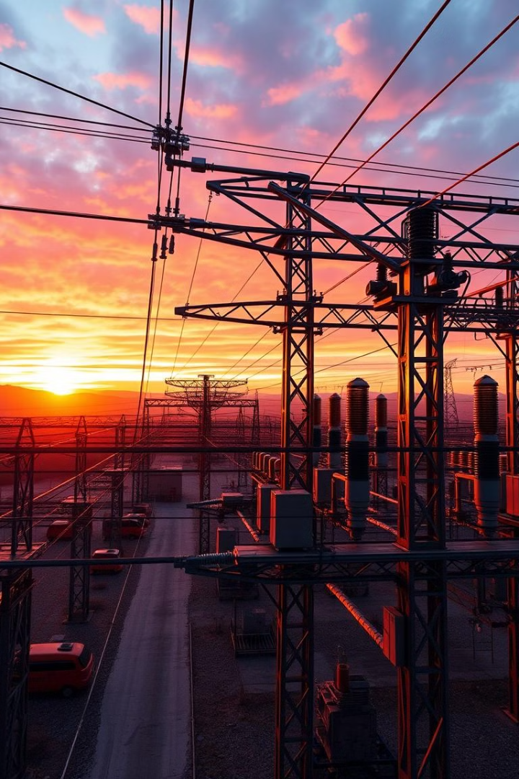
BCSE498J Project-II: Data Analysis Framework for Power Distribution
Developed to enhance operational efficiency at Suryaa Chamball Power Limited (SCPL).
Presented by Tanmay Agarwal. 21BDS0347

Slide 2
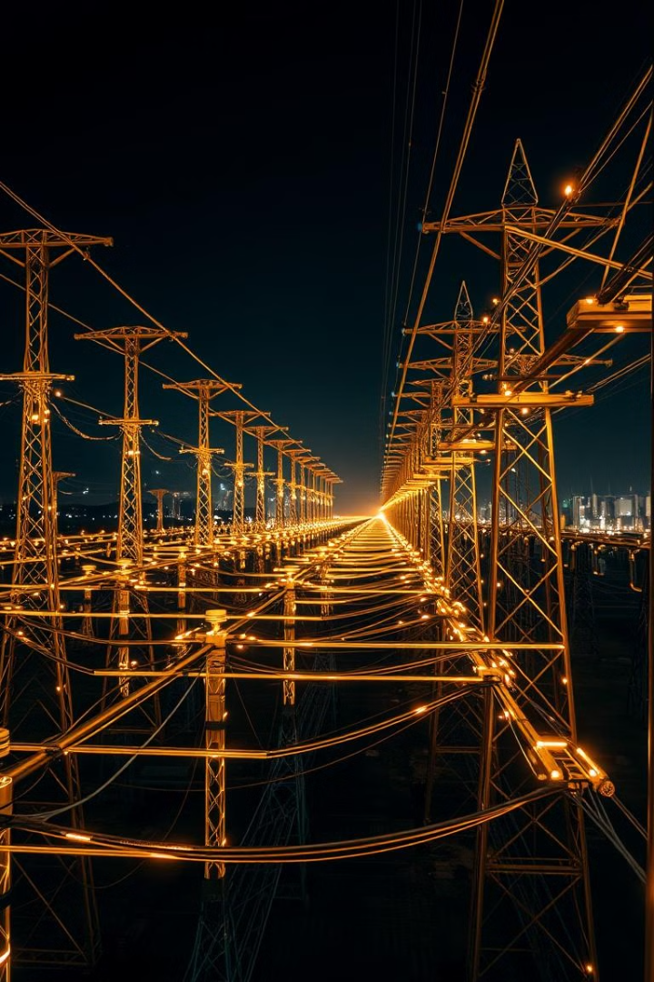
Project Overview: Enhancing Power Distribution Efficiency
Objective
Framework
Impact
Analyze power consumption patterns, detect inefficiencies, and automate reporting.
Data pipeline development, predictive modeling, anomaly detection, and visualization.
Reduce manual effort, improve power loss predictions, and enhance visualization.

Slide 3
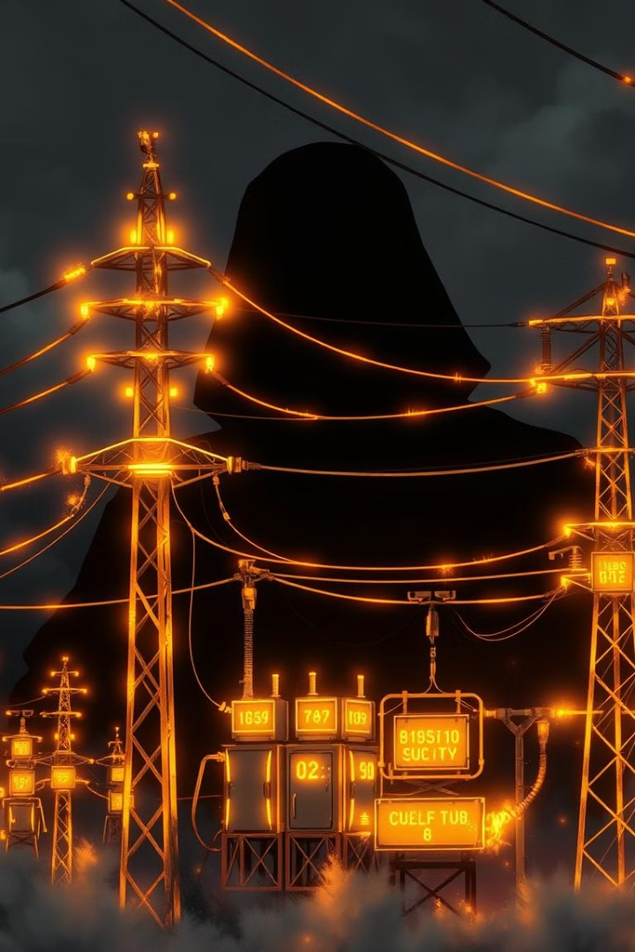
Background: Challenges in Power Distribution
1
Complexity
2
Inefficiencies
Aging infrastructure, rising consumption, and real-time monitoring needs.
High energy losses, delayed fault detection, and lack of predictive insights.
3
Solution
Data-driven approach using AI and ML for enhanced efficiency.

Slide 4
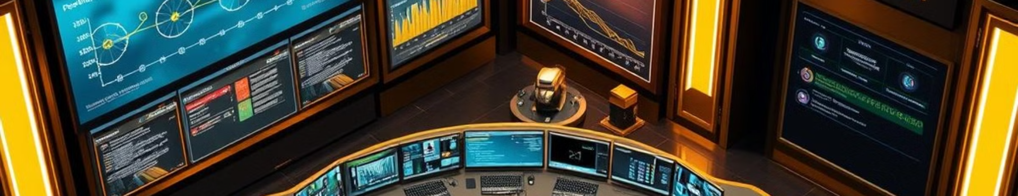




Project Goals: A Data-Driven Solution
Scalable Data Pipeline
ML Model Training
Interactive Dashboards
Enhanced Efficiency
Power loss prediction and anomaly detection.
Automated data ingestion and preprocessing.
Real-time visualization and reporting.
Automation and predictive insights.

Slide 5
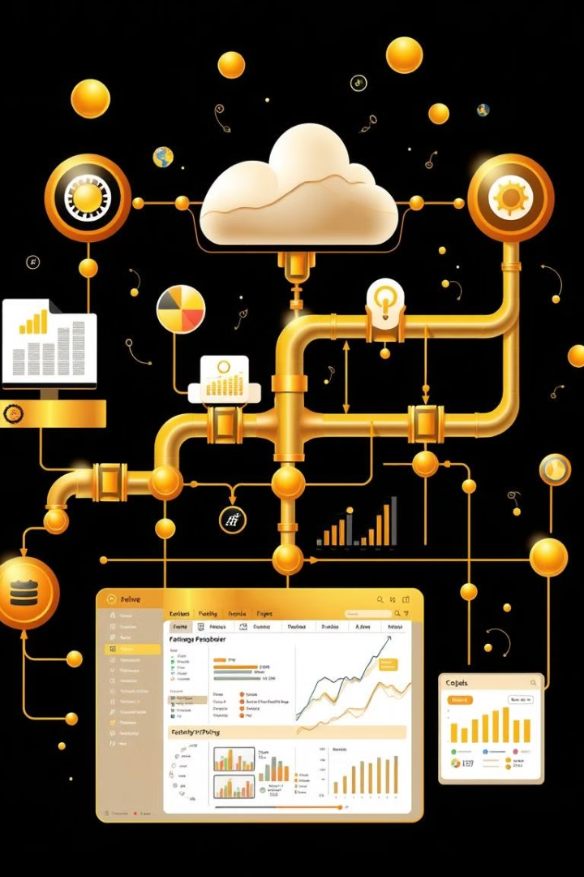



Requirement Analysis: System Essentials
Automated Pipeline
ML Integration
Visualization
Predictive models to forecast energy losses.
Interactive dashboards for energy trends.
Fetch, clean, and store data automatically.

Slide 6




System Architecture: Real-Time Monitoring Framework
Data Ingestion
1
Data Storage
Collect raw data.
2
Store data in cloud.
Visualization
4
Data Processing
3
Display insights.
Clean and analyze data.

Slide 7
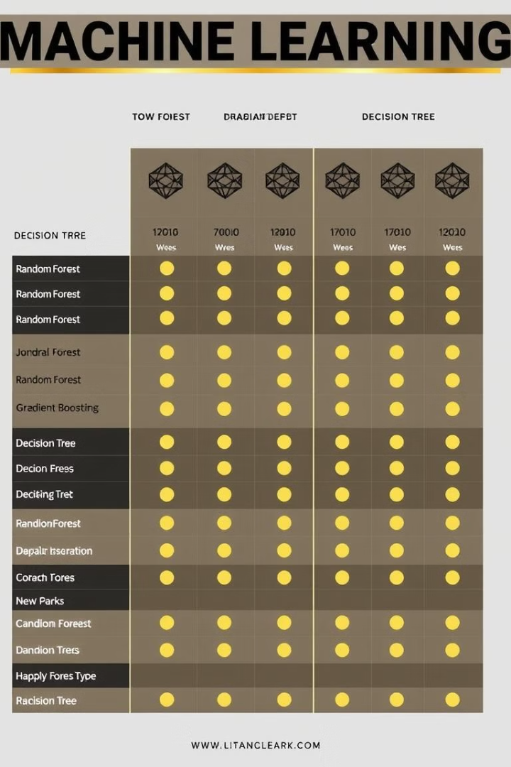
Model Comparison: Performance Metrics
Model
MAE
MSE
RMSE
R² Score
Random Forest
2.14
5.23
2.29
0.92
Gradient Boosting
2.01
4.75
2.18
0.94
Decision Tree
3.25
8.45
2.91
0.85

Slide 8

Specifications: Hardware and Software
Hardware
Software
AWS EC2 instances
Python, SQL
Local servers
Power BI
Smart meters
PostgreSQL

Slide 9

Model Design and Implementation
Predictive Model
Dashboard
Anomaly Detection
Forecast energy losses effectively.
Display consumption trends.
Alerts for irregularities.

Slide 10

References: Key Resources
Smith, J. (2021). Energy Analytics for Smart Grids.
Patel, R. (2020). Machine Learning in Power Distribution.
Chen, L., & Zhang, X. (2019). Deep Learning for Energy Forecasting.

